Slide 1

EEE.620.FOUNDATIONS OF ENTREPRENEURSHIP - BUSINESS PITCH
TEAM - 3
REAL FERTILIZER
PREPARED FOR TEACHING PROFESSOR : ERIC ALDERMAN

Slide 2

TEAM
SUBMITTED BY :
SHIVA DHANUSH MALLELA (smallela@syr.edu)
SRAVAN KUMAR MANDHADAPU (smandhad@syr.edu)
RISHI SIDDANTH YAGA (riyaga@syr.edu)
MANJUSHA BADDIPUDI (mbaddipu@syr.edu)

Slide 3
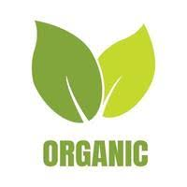
PROBLEM
Despite the increasing demand for organic products, there are several challenges faced by organic products businesses. These challenges include but are not limited to, high production costs, limited availability of organic inputs, difficulty in sourcing raw materials, and intense competition from conventional products.
Furthermore, there is a lack of awareness and understanding among consumers regarding the benefits of organic products, leading to low demand and sales. As a result, organic products businesses struggle to maintain profitability and growth in the market.

Slide 4

ADVANTAGES TO POTENTIAL INVESTORS
Strong commitment to sustainability: One of the unique features of an organic products business is the focus on sustainability and environmental responsibility. By incorporating sustainable practices into the production process, such as using renewable energy sources and reducing waste, the business can set itself apart from competitors and appeal to environmentally conscious consumers.
Access to high-quality organic inputs: By establishing relationships with trusted suppliers and investing in organic farming practices, the business can ensure a consistent supply of high-quality organic inputs to customers.
Differentiated product offerings: The organic products business can differentiate itself from competitors by offering unique and innovative products that appeal to specific niches within the organic products market. Our Real Fertilizer offers free trial for first 5 days and then people can opt for paid subscription. We also provide customization of organic products which is unique to every individual.
Strong branding and marketing: To address the lack of awareness and understanding among consumers regarding the benefits of organic products, the business can invest in strong branding and marketing efforts. By effectively communicating the benefits of organic products and creating a strong brand identity, the business can build a loyal customer base and increase sales.
Diversified distribution channels: To reach a wider audience, the business can adopt a multi-channel distribution strategy that includes both online and offline sales channels.
At Present our business is completely on online platform through our official website. Once our business becomes stable, we plan to partner with retailers and sell our products offline.

Slide 5

SOLUTIONS
Investing in organic farming methods: Our company can guarantee a steady supply of high-quality organic inputs for its products by making an investment in organic farming methods. This might entail developing connections with dependable vendors, assisting regional farmers, and making investments in environmentally friendly farming techniques like crop rotation and composting.
Establishing long-term relationships with suppliers will help our company ensure a consistent supply of organic inputs. Our company can improve input quality and negotiate better prices by collaborating closely with suppliers.
Consumer education: Our company tries to educate people about the importance of organic food through our Instagram page.
Creating innovative products: Our company can create distinctive products that address customer needs or preferences in order to stand out from the competition.
Multi-channel distribution strategy: Our company can use a multi-channel distribution strategy that combines online and offline sales channels in order to reach a larger audience. This might entail joining forces with e-commerce platforms, promoting products through retail stores, or attending organic products fairs or events.

Slide 6
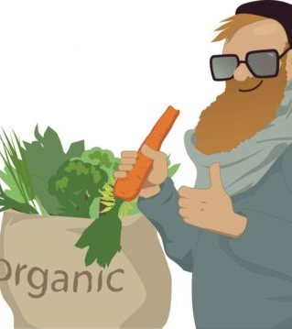
PRODUCT
Our Organic products are produced without the use of synthetic pesticides, fertilizers, or other harmful chemicals. They are grown using sustainable farming practices that prioritize the health and well-being of the soil, water, and surrounding ecosystem.
There are several benefits to using our organic products:
Health benefits: Our Organic products are free from harmful chemicals and pesticides that can potentially harm human health. They are also more nutritious, as studies have shown that organic fruits and vegetables have higher levels of nutrients such as Vitamin C, iron, and magnesium.
Environmental benefits: Organic farming practices prioritize the health and well-being of the environment. They promote biodiversity, reduce soil erosion, and minimize water pollution.
Support for local farmers: Choosing to buy organic products supports local farmers who use sustainable farming practices, which helps to strengthen local economies.
Higher quality: Our Organic products are typically higher in quality and taste better than conventionally grown products. They are often fresher and have a more natural flavor.
Overall, Our organic products offer a safer, healthier, and more sustainable alternative to conventionally grown products. By choosing to use Our organic products, consumers can make a positive impact on their health, the environment, and their local communities.
This Photo by Unknown Author is licensed under CC BY

Slide 7

TRACTION
Positive customer feedback: A startup in the organic products industry could highlight positive customer feedback as a measure of success. This could include reviews on our website & social media, testimonials from satisfied customers, or surveys showing high customer satisfaction rates.
Sales growth: A startup could also demonstrate traction through sales growth. This could include year-over-year increases in sales, growth in customer base, or expansion into new markets.
Partnerships and collaborations: Building partnerships and collaborations with other retailers in the organic products industry could be another measure of success. This could expand the product range or reach new audiences.
Media attention: A startup that has received media attention, such as positive reviews in magazines or online publications, can use this as a measure of success and a way to increase brand awareness.
Awards and recognition: Winning awards and receiving recognition in the industry or local community can also be a measure of success for our business. This could include recognition for sustainability practices, product innovation, or community involvement.

Slide 8

MARKET
The market for our organic products is a growing and competitive one, with a wide range of players and products available to consumers on our website.
According to a report by Grand View Research, the global organic food and beverage market was valued at USD 91.40 billion in 2020 and is expected to grow at a compound annual growth rate (CAGR) of 11.6% from 2021 to 2028.
To succeed in this market, our organic products business must differentiate itself from its competitors and target a specific niche or customer segment. This can be achieved through product innovation, marketing and branding efforts, and establishing relationships with suppliers and retailers.

Slide 9

COMPETITION
In the market for organic products, a new business must compete with both direct and indirect competitors. Direct competitors are other businesses that offer similar products and target the same customer segment, while indirect competitors are businesses that offer substitute or complementary products.
Direct competitors for our organic products market may include:
Smaller independent businesses: These businesses may specialize in specific organic products or niches, such as organic produce or snacks.
Online retailers: Companies such as Amazon and Thrive Market offer a wide range of organic products to customers across the globe.
Indirect competitors for our organic products market may include:
Conventional products: Consumers may choose to purchase conventional products instead of organic products, either due to price or lack of awareness of the benefits of organic products.
Health food stores: Stores that specialize in health and wellness products, such as Whole Foods or Trader Joe's, may offer a range of organic products alongside conventional products.
Farmers markets: Consumers may choose to purchase organic produce from farmers markets instead of supermarkets or online retailers.
To compete effectively in this market, our organic products business must differentiate itself from its competitors by offering unique products, establishing a strong brand identity, and developing effective marketing and distribution strategies. This can include developing innovative product lines, leveraging social media and influencer marketing to build brand awareness, and building relationships with trusted suppliers and retailers. It's important to conduct regular competitor analysis and stay up-to-date on industry trends to remain competitive and meet customer needs.

Slide 10
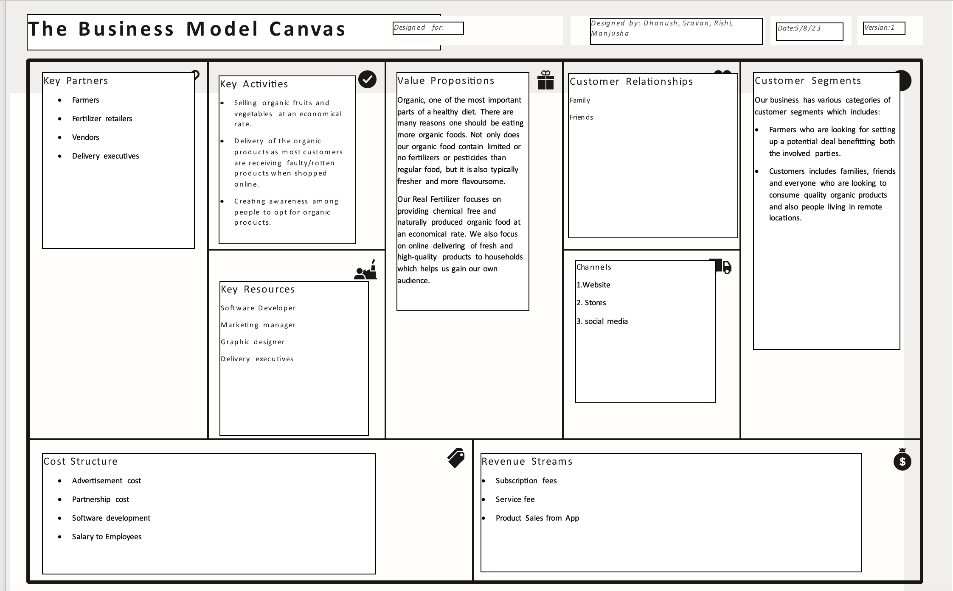
BUSINESS MODEL

Slide 11

INVESTING
We estimate that we will need a total initial investment of $950,000 to cover our startup costs and initial operating expenses. The breakdown of our budget is as follows:
Our salaries are costing 3,62,000 per year for 7 employees (4 founders and 3 employees including software developer, marketing manager and graphic designer)
Total Real Estate cost is $870 which has 30 sq. Ft with $27/sq. Ft.
Our CAC is through google display network which costs $63.59 per person through website, $26.77 per person through Instagram visits totaling $3,27,475 for 5960 Adopters.
Our LTV is $1800 per person.
Our hardware and other miscellaneous expenses costs around $27,700.
This Photo by Unknown Author is licensed under CC BY-ND

Slide 12

WEBSITE : https://mandadapusravankum.wixsite.com/real-fertilizer
SOCIAL MEDIA: https://instagram.com/realfertilizer604?igshid=NTc4MTIwNjQ2YQ== CONTACT: (+1) 315-766-4440
This Photo by Unknown Author is licensed under CC BY

